Slide 1
The Case
Introduction for RoboCup
4th Challenge

Slide 2
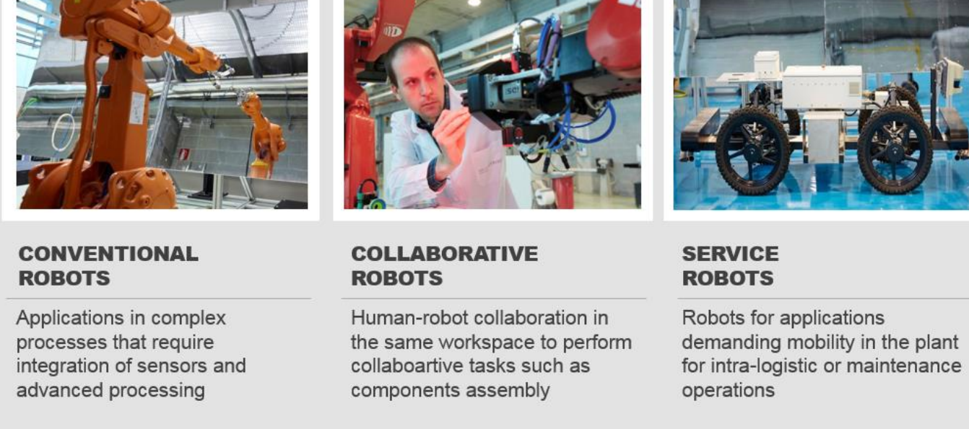
Introduction for Collaborative Robotics
Type of Robots in Industry:

Slide 3
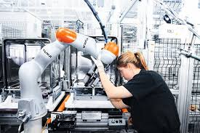
Introduction for Collaborative Robotics
Why collaborative?
Physical interaction with human beings
Safety / Security
New challenges (AI, Neural Networks)

Slide 4
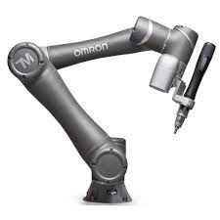
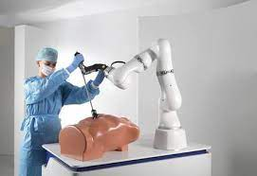
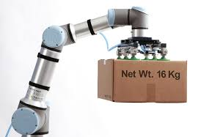
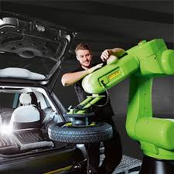
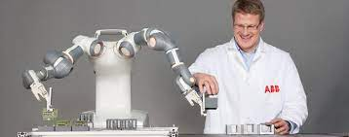
Introduction for Collaborative Robotics
Main Manufacturers
Universal Robots
Omron
KUKA
Abb
Fanuc

Slide 5
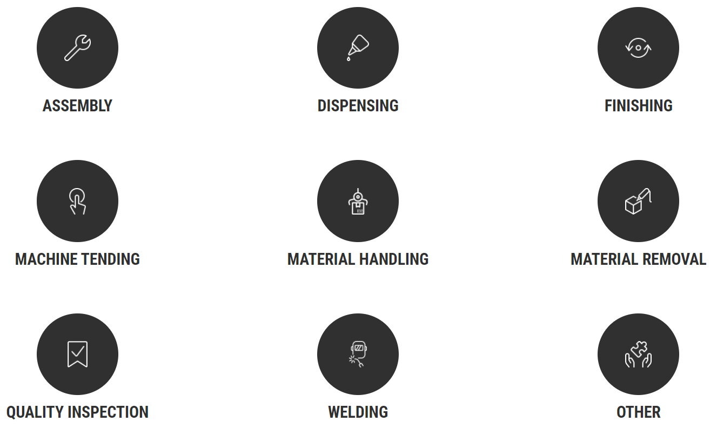
Introduction for Collaborative Robotics
Main applications
Screwdriving
Part Insertion
Gluing
Sealing
Painting
Sanding
Polishing
CNC
Injection molding
Packaging
Palletizing
Bin Picking
Grinding
Drilling
Testing
Measuring
Arc
Soldering

Slide 6
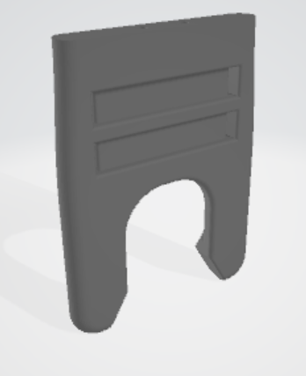
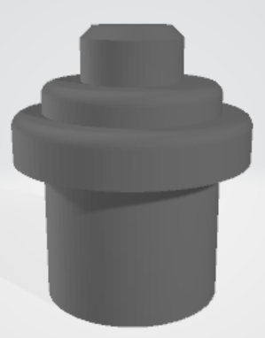
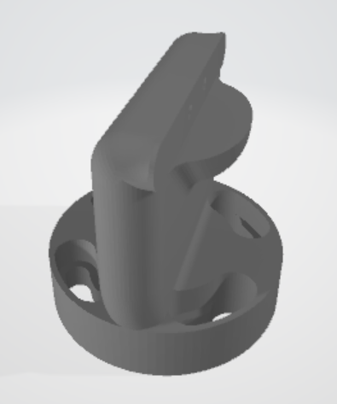
Previously in Finland
Design from first challenge:
GRIPPER FOR MATERIAL HANDLING
Design of a collaborative gripper
No Pneumatics
No Electronics
Pure Mechanics
Pieces to handle
Adapt for handling
Good/bad material check

Slide 7
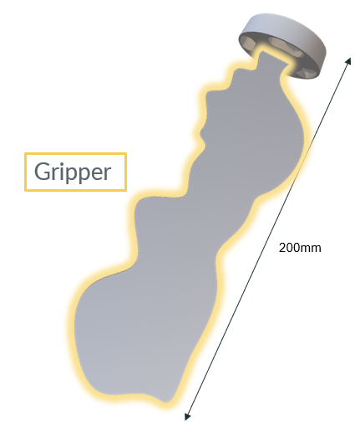
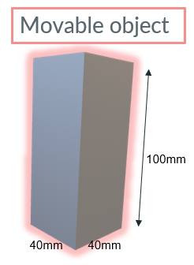
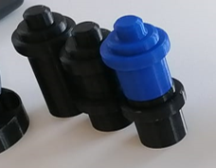
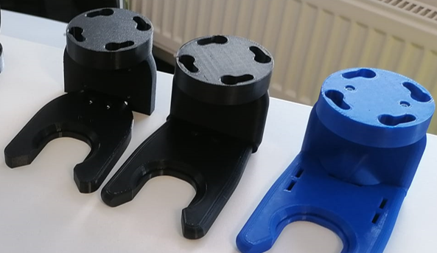
Previously in Denmark
Geometric restrictions:
FIRST CHALLENGE SOLUTION:
Movable object:
- 3x stackable in different ways

Slide 8
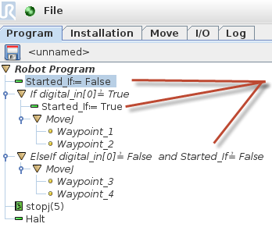
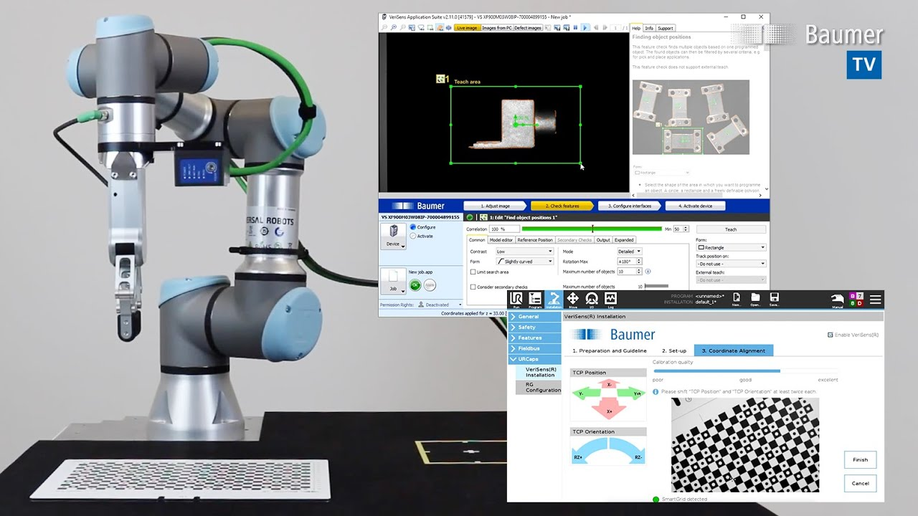
Previously in Denmark
UR Robot Programming –2nd Challenge
Easy to understand
Easy to change (positions, DI/DOs,…)
Different types of palletizing / Different options
Different size pallets
Stack in different ways
Different positions
One on top of another
Scripting (optional)

Slide 9
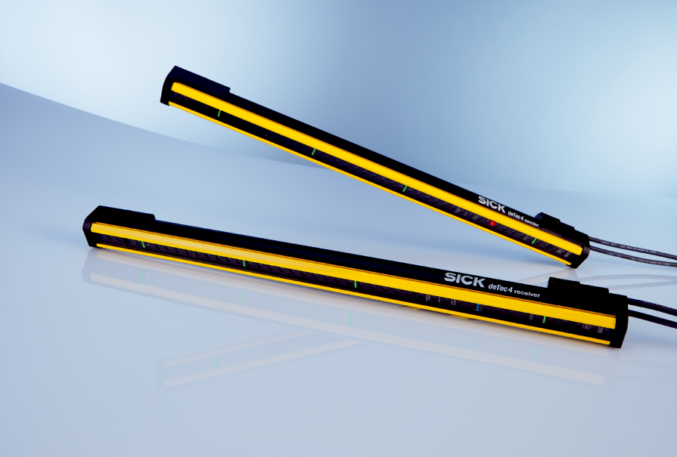
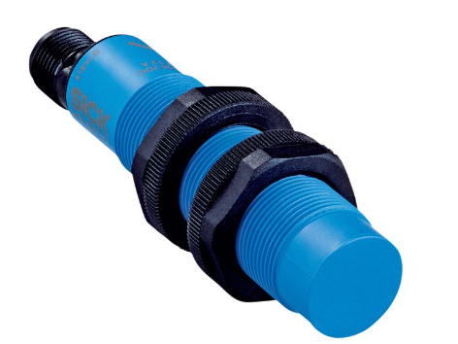
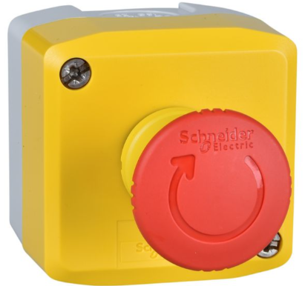
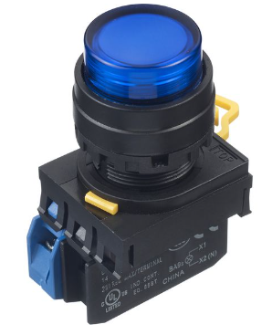
Previously in Norway New ways of interacting with the robot
Capacitive sensor
SICK CM18-12NPP-KC1
To detect if the piece is in the
gripper.
Safety light curtain
deTec 4 C4P-SA03031A00
To detect if the robot can operate
safely
Emergency stop button
Schneider Electric 135-12-364
To stop the robot in the case of an emergency
Light up buttons (start,stop,reset)
IDEC YW1L-M2E10Q4S
To interact with the application

Slide 10
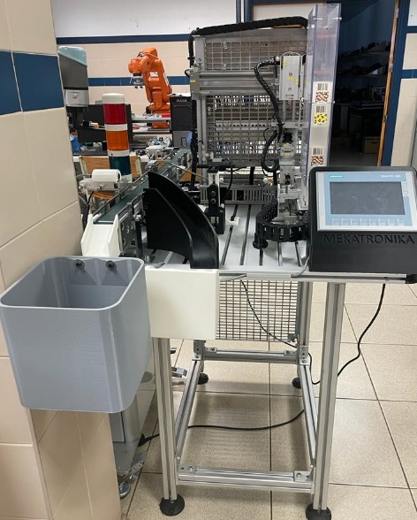
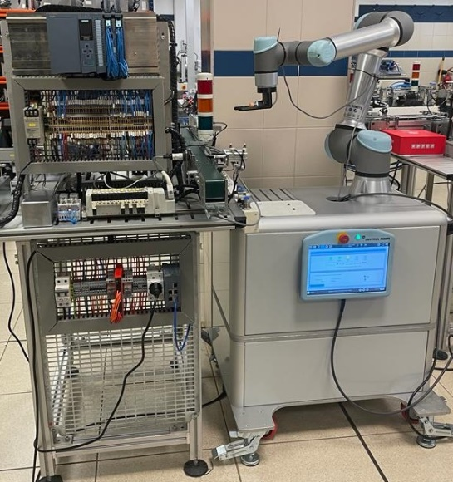
Our Case – Here Vitoria-Gasteiz
You will need to classify boxes depending on the color of the piece. The red pieces are going to be the bad ones and should be rejected and the black ones are going to be the good ones. So each box depending on the color of the piece that should be inside should go one way or another

Slide 11
Our Case – Here in Vitoria-Gasteiz
A Siemens PLC will control the whole application.
To do so, you will have to program it using TIA PORTAL.
According to the signals from the sensors the pieces will travel on the conveyors and will follow the correspondent pathway either to the dismissed pieces’ place or to the good one.
After a box is positioned to be palletized, the PLC will send the robot the starting signal and the robot will load one piece to it.
You will have to program an HMI, to provide the number of pieces to be palletized.
After we have chosen the number of pieces to be palletized the application will start by pressing a pushbutton or a start button in the HMI.

Slide 12
Documentation
Presentation: Prepare to explain your SOLUTION
FRIDAY-9:00
Documentation/Report:
(Replicate the Project)
Task Explanation
Objectives of the project
Steps done
Materials/Tools/Software used
Conclusions
Risk Assessment
Template

Slide 13
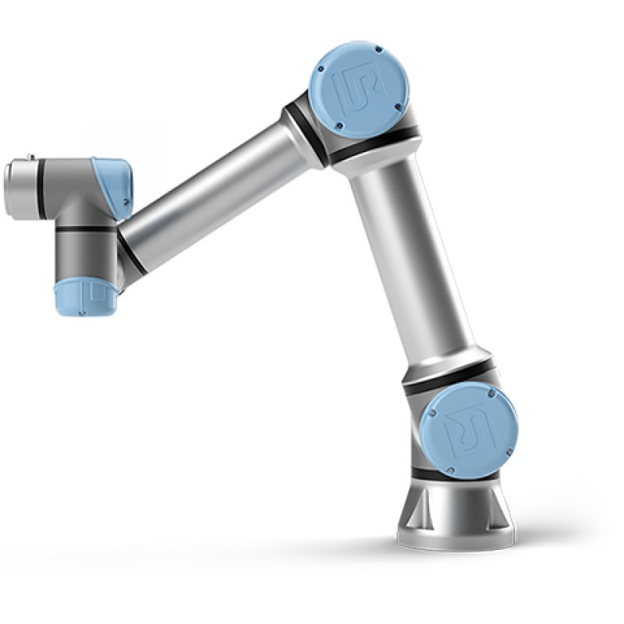
Software and resources
UR VIRTUAL MACHINE FOR TESTING
DOWNLOAD & MANUAL
MICROSOFT OFFICE OR GOOGLE DOCs
EXCEL TEMPLATE FOR RISK ASSESSMENT

Slide 14
Links
TIA PORTAL V16 DOWNLOAD
STEP BY STEP GUIDE FOR COMMUNICATION WITH TIA PORTAL + GSD
COMMUNICATION BETWEEN PLC WITH UR-ROBOT (VIDEO)
UR-ROBOT PROGRAMMING
Creating a program
Palletizing/depalletizing module

Slide 15
TIME TO START

